Slide 1
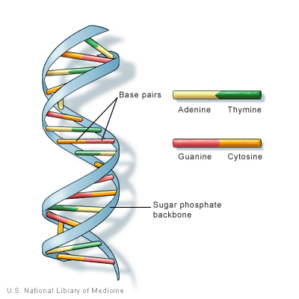
What are genes?

Slide 2
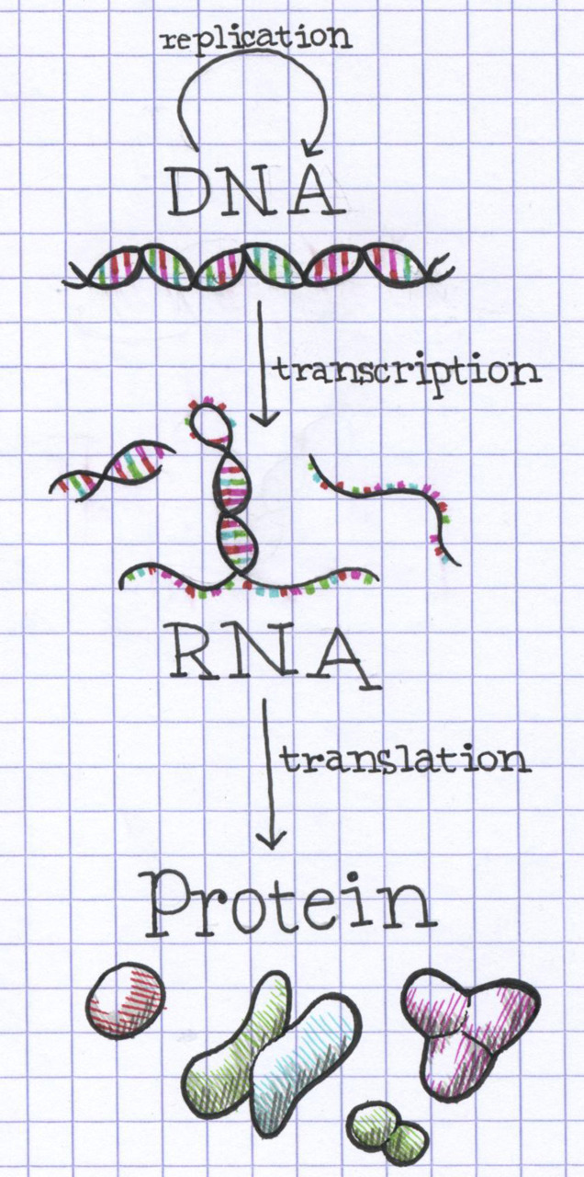
Central Dogma of Biology

Slide 3
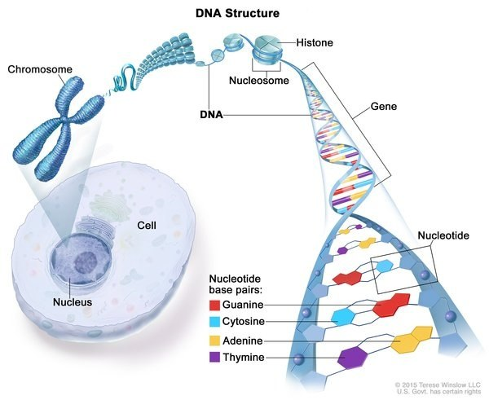
DNA in your cells
Notes:
ATGAATGC

Slide 4
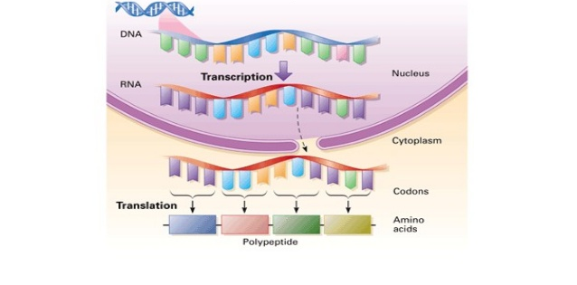

Slide 5
Personal Genetics

Slide 6
Do Now
Discuss the following questions with the person (or people) next to you:
What are the potential benefits to knowing more about your likelihood of developing a genetic disease?
What are the possible downsides to knowing?
Aside from health and medical information, what else might you be curious to learn about from your DNA?
Notes:
Slide notes: The questions for this “Do Now” activity are a good way to start discussions. Allow students a few minutes to respond and discuss.

Slide 7
Genetics is getting more personal
because learning about our own
DNA is rapidly becoming
inexpensive and accessible.
DNA analysis can provide:
Insights about our health, behavior, family history and other traits.
Highly personal information with personal, social and familial impact.
Information about genes and traits available to consumers through their doctor.
Notes:
Slide notes: New DNA sequencing technologies are quickly making it faster and less expensive to learn about one’s DNA. The cost of finding out your entire DNA sequence is anticipated to decrease so quickly that, within ten years, your physician might request your genome be sequenced as part of routine blood-work, possibly covered by health insurance. Some genetic tests are directly available to consumers and are referred to as direct-to-consumer (DTC) testing. Typically, companies sell kits via the internet that provide a tube for saliva and instruct customers to spit into the tube and then mail the tube back to the company. The company then isolates DNA from the saliva and analyzes the DNA, often looking at a small fraction of the genome rather than the entire genome. Customers receive a report that provides an interpretation of the DNA analysis; this often includes genetic predictions about their traits such as their genetic predisposition for various diseases.
Your DNA can reveal important information about your traits. It is important to remember that your physical, mental and behavioral states are the result of complex interactions between multiple genes in combination with your environment and lifestyle. Learning about your DNA is highly personal and also raises many questions about how we as a society are going to handle the accessibility of genetic information. For example, if you learn about your risk for Alzheimer‘s disease, this may raise concerns for your mother, who might not want to know anything about her risk for Alzheimer’s disease. Might easy access to genetic predispositions affect dating relationships? Should insurance companies be able to know information about your DNA? These are a few of the issues that this lesson will explore.

Slide 8
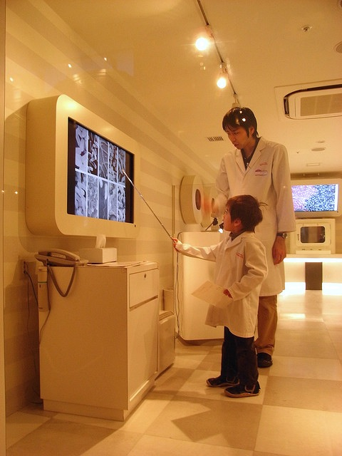
Why might personal genetics matter to you?
Genome analysis available for under $1,000 dollars
Broadly available in the next 5-10 years
Transforming medical care for the next generation
Image: James Hart, CC BY-NC-ND 2.0
Notes:
Image: “Kidzania – Doctor” by James Hart (https://www.flickr.com/photos/jameshart/3216713992/, accessed Jan 25, 2016). Available under a Creative Commons Attribution-NonCommercial-NoDerivs 2.0 Generic License (https://creativecommons.org/licenses/by-nc-nd/2.0/).
Slide notes: The generation that is now in middle and high school likely will be impacted more by the increase in genetic information than any previous generation. Doctors and scientists think of the “$1,000 genome” as an important milestone because at this cost (or less), personal genome sequencing will be comparable in cost to other routine medical tests, such as an MRI, and may become a common tool to help diagnose disease and indicate treatment options. In 2015, many companies believe they are within striking distance of being able to sequence a human genome for roughly $1,000 (US).

Slide 9
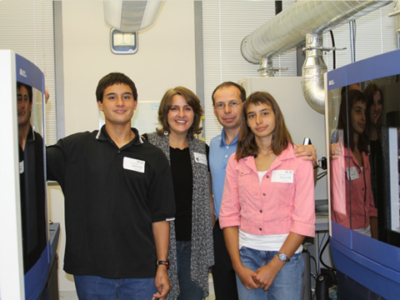
The Beery twins’ story highlights
the promise of personalized medicine
http://dystonia.thebeerys.com/
Notes:
Image: Retty Beery, The Beerys Dystonia Support Site Web Site (http://dystonia.thebeerys.com/, accessed Jan 25, 2016)
Slide notes: Genome sequencing has already had real-world impact on patients, including twins Alexis and Noah Beery. The twins exhibited a number of developmental delays and were diagnosed with cerebral palsy at the age of two. However, their mother, Retta, never felt that this diagnosis was correct, particularly since their symptoms worsened over the course of the day. Through their mother’s research and advocacy, the twins were diagnosed with a genetic disorder called dopa-responsive dystonia and began taking a medication that seemed to successfully treat the condition. However, some symptoms persisted and escalated, particularly for Alexis, including serious breathing problems. The Beery family had the twins' genomes sequenced, leading to the identification of a mutation in the SPR gene which, when disrupted, causes deficiencies in two neurotransmitters, called dopamine and serotonin. Upon treatment to restore dopamine and seratonin, the twins’ symptoms quickly improved, permitting them to resume full, active lives.

Slide 10
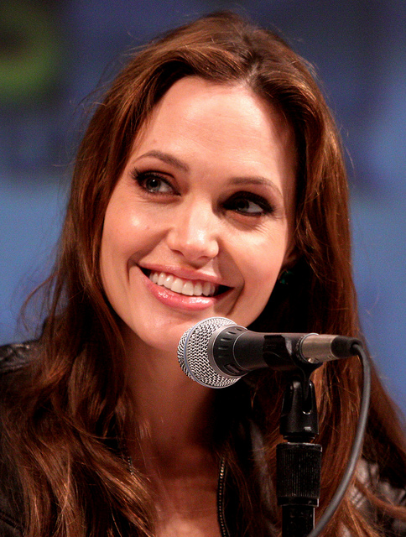
Personal choices based on
genetic information
Angelina Jolie reveals she chose to undergo a double mastectomy.
Jolie had a genetic test and found she carried a mutation in the BRCA1 gene. Doctors estimated there was a very high chance she would get breast cancer.
Image: Gage Skidmore, CC BY-SA 2.0
Notes:
Image: “Angelina Jolie” by Gage Skidmore (https://www.flickr.com/photos/gageskidmore/4860509634/, accessed Jan 25, 2016). Available under a Creative Commons Attribution-ShareAlike 2.0 Generic license (https://creativecommons.org/licenses/by-sa/2.0/).
Slide notes: In May 2013, actress Angelina Jolie revealed that she had undergone a double mastectomy because she carries a mutation in the BRCA1 gene that greatly increased her risk of breast and ovarian cancer. According to Jolie’s op-ed “My Medical Choice” in the New York Times, her “chances of developing breast cancer have dropped from 87 percent to under 5 percent.” This is a great way to engage students with a real-life example of a well-known person making a major medical decision based on genetic information.

Slide 11
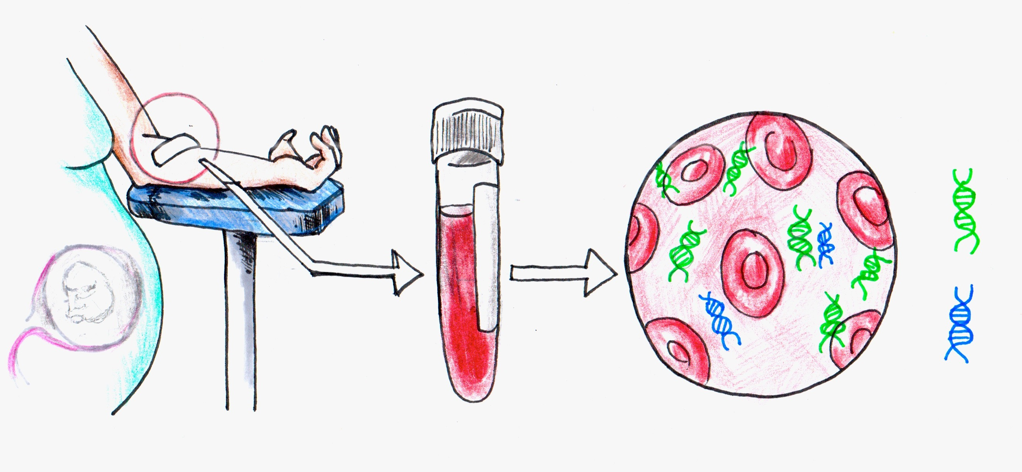
Non-Invasive Prenatal Testing (NIPT)
Fetus and mother share a blood supply.
Fetal cells release DNA that enters the maternal bloodstream.
Maternal blood now contains a mixture of maternal cell-free DNA and fetal cell-free DNA.
Notes:
Image: Personal Genetics Education Project (Patricia Hautea)
Slide notes: It is now possible to analyze DNA from a fetus through a test performed on a blood sample from the pregnant mother. This is known as non-invasive prenatal testing (NIPT). Every individual begins from the fusion of an egg with a sperm, which results in an embryo that eventually develops into a fetus. Except for the very earliest stages of embryonic development, the embryo and the fetus is connected to the mother by an organ called the placenta. The placenta facilitates nutrient uptake and waste disposal. Sometimes placental cells break open, releasing fragmented fetal DNA into the blood. This “cell-free” fetal DNA can then enter the mother's bloodstream. There, it mixes with cell-free DNA that has been released from cells in the mother's body. Cell-free fetal DNA makes up a small fraction of the cell-free DNA found in the mother's bloodstream. Since the mother's blood circulates throughout her body, a blood sample taken from the mother's arm will contain cell-free fetal DNA. Extracting cell-free DNA from the mother's blood will give a mix of maternal and fetal DNA. Physicians and researchers have now found a way to analyze this cell-free DNA to reveal information about the developing fetus. While sorting maternal from fetal DNA can still be challenging, the technology has developed to a point where it is being used for NIPT.

Slide 12
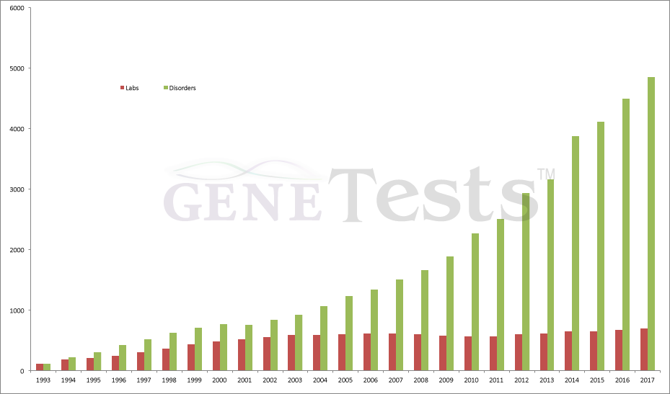
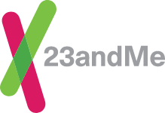
Personal Genome Sequencing
Genetic testing
for disease
- Precision medicine?

Slide 13
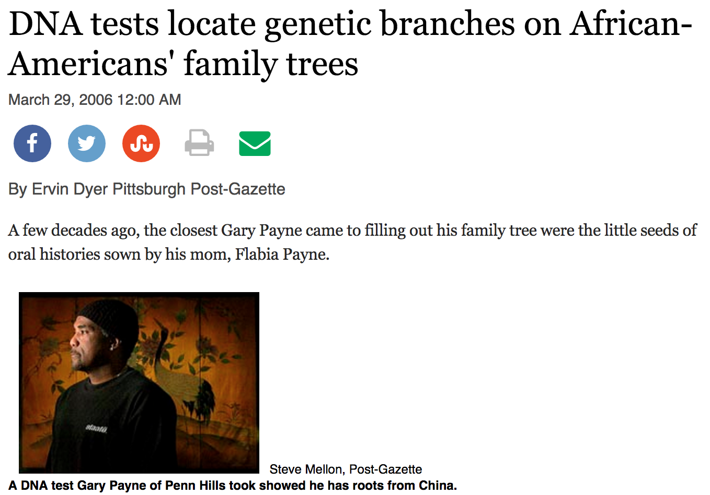

http://www.post-gazette.com/lifestyle/2006/03/29/
DNA-tests-locate-genetic-branches-on-African-Americans-family-trees/stories/200603290216
Notes:
Image: http://www.post-gazette.com/lifestyle/2006/03/29/DNA-tests-locate-genetic-branches-on-African-Americans-family-trees/stories/200603290216
(Accessed on January 25, 2016)
Slide notes: DNA tests can be used to help people learn about their ancestry, particularly when a person’s family history is unknown for various reasons. For example, because of the history of slavery in the United States, many people of African ancestry do not know in what part of Africa their ancestors lived. Other people may not know any ancestry information or family health history if they are adopted or conceived from a donor egg or sperm. DNA testing can fill in these gaps and may allow people to feel more connected to a past of which they were previously unaware.
Gary Payne, pictured in the slide, was interested in his family’s genealogy but his mother and other relatives only had limited information that went back a couple of generations. He had his DNA tested in an attempt to discover more specific information about his background. He was shocked to learn that his father was of Chinese descent, with his DNA test indicating a strong link to the Han people. His story is an example of the many people who have limited information from oral or written family histories and are able to fill in the gap with genetic information, and with the ways in which this new information can impact identity.

Slide 14
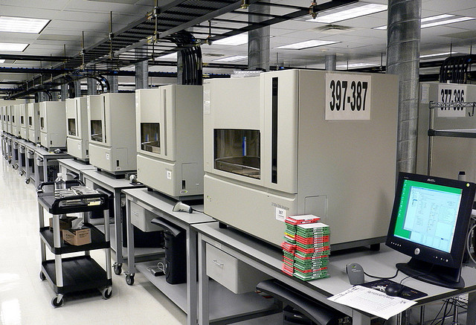
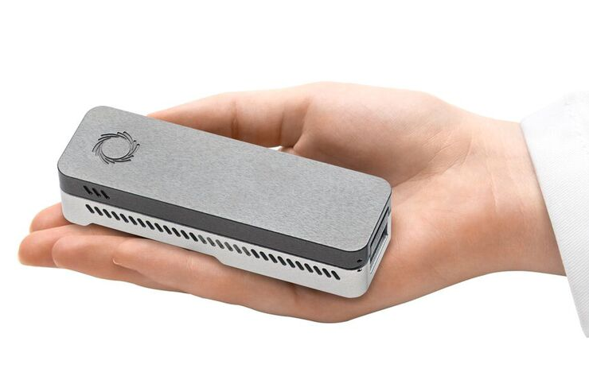
Genome sequencing technology
Applied Biosystems 3730 DNA Analyzers
2002
Oxford Nanopore
MinION
2014
(left) Photo by Jurvetson, flickr, CC BY 2.0; (right) Oxford Nanopore Technologies
Notes:
Image (left): (left) “Riding Shotgun” by Steve Jurvetson (http://www.flickr.com/photos/jurvetson/57080968/, accessed Jan 25, 2016). Available under a Creative Commons Attribution 2.0 Generic license (https://creativecommons.org/licenses/by/2.0/).
Image (right): Oxford Nanopore Technologies (https://nanoporetech.com/downloads/MinION-hand.jpg, accessed on Jan 25, 2016).
Slide notes: The first sequence of the human genome was achieved with hundreds of sequencing machines working for years. Now a single machine can sequence a full human genome in a matter of days. (Note, the analysis takes much longer than the actual process of sequencing.) To make the sequencing technology more accessible, there has also been a push to make sequencing machines smaller and more affordable. For example, some companies (e.g., Genia, Genapsys and Oxford Nanopore) are developing sequencing machines that are the size of a loaf of bread or even a bar of soap.

Slide 15
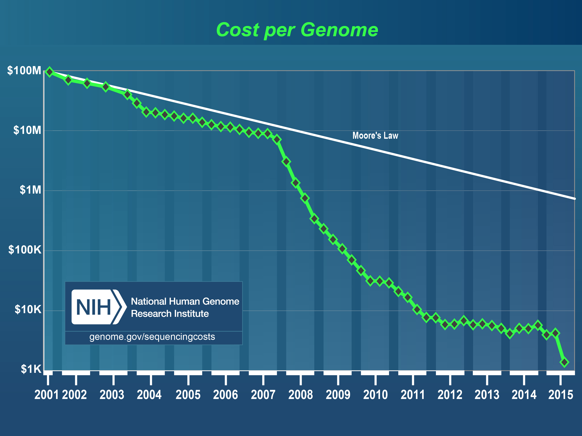
Notes:
Image: Graph is available at http://www.genome.gov/sequencingcosts/
Slide notes: In 2016, companies continue to compete to reduce the cost of sequencing a human genome. In the coming years, perhaps reading human genomes might be as routine as blood tests and might be carried out in your doctor’s office. The graph in the slide is regularly updated by the National Human Genome Research Institute and is available at http://www.genome.gov/sequencingcosts/.

Slide 16

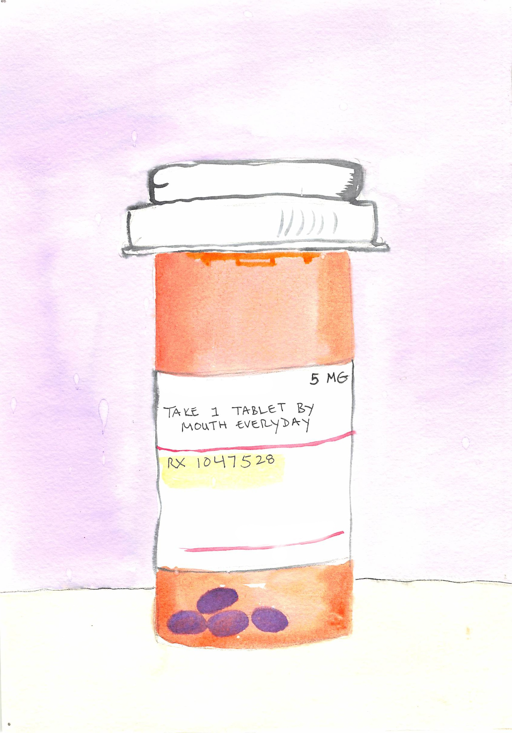
What could you learn from genetic testing?
- Risk for conditions including:
Alzheimer’s Disease
Heart Disease
Cancer
- Carrier Status
- Which medications could work best for you and/or which could harm you
- Ancestry
Notes:
Image: (left) Adapted from Madeleine Price Ball (https://commons.wikimedia.org/wiki/File:Silhouette_of_Woman_with_Short_Hair_and_Jeans.svg, accessed Feb 16, 2016).
(right) Personal Genetics Education Project (Dana Waring)
Slide notes:

Slide 17
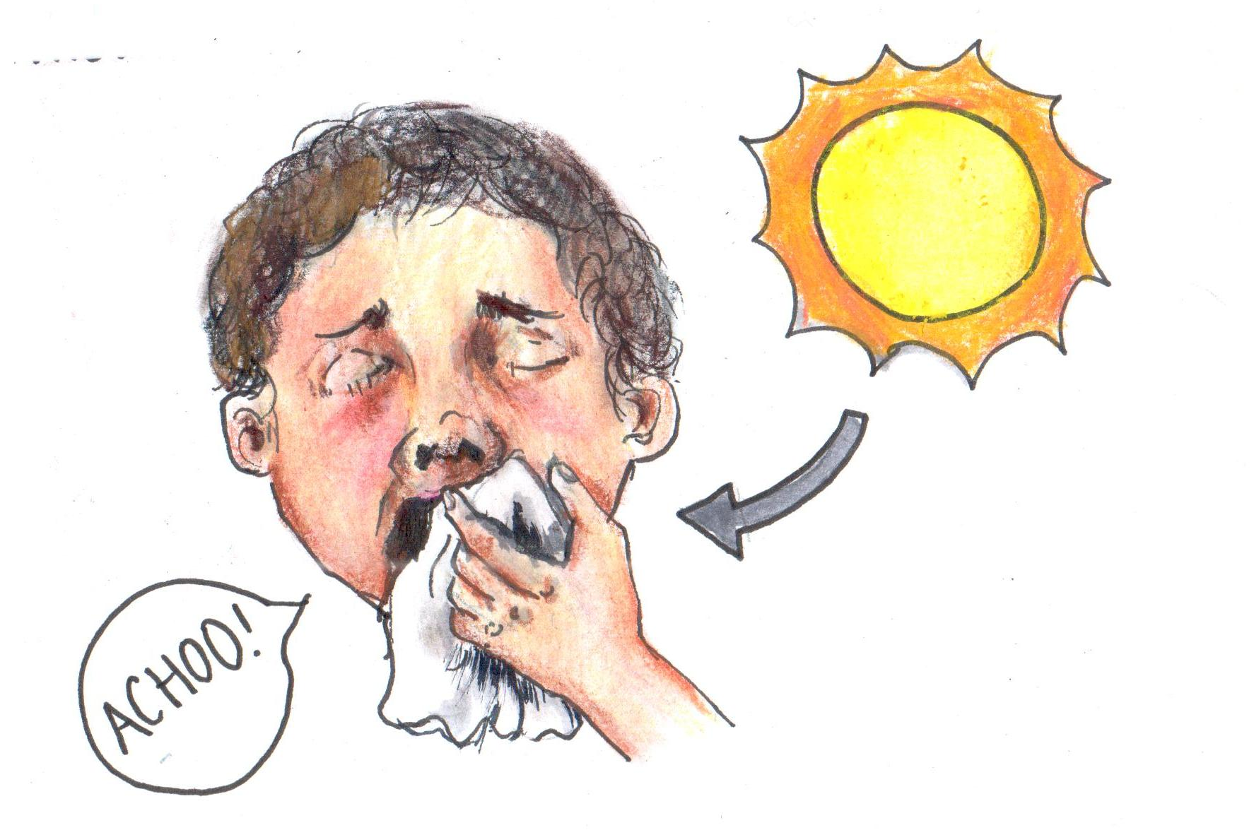
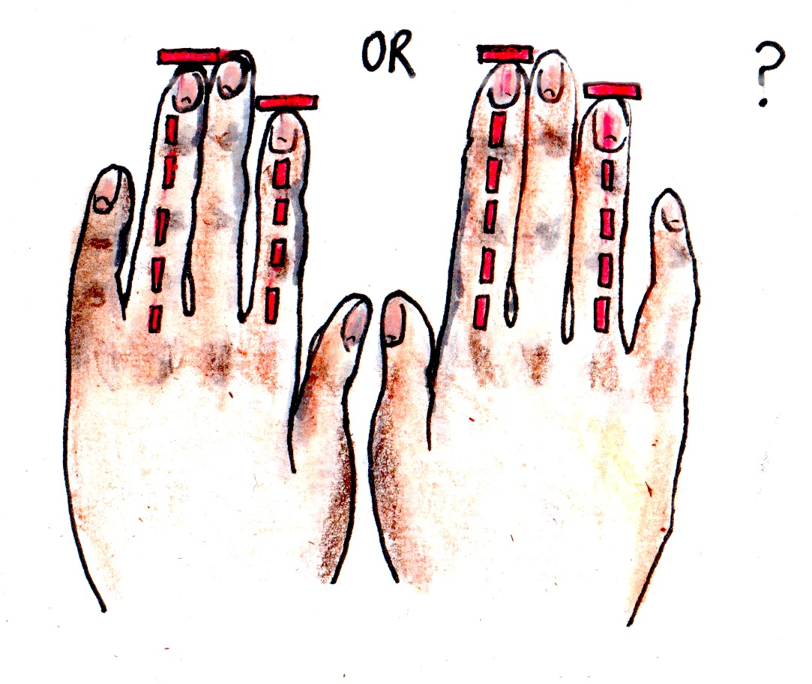
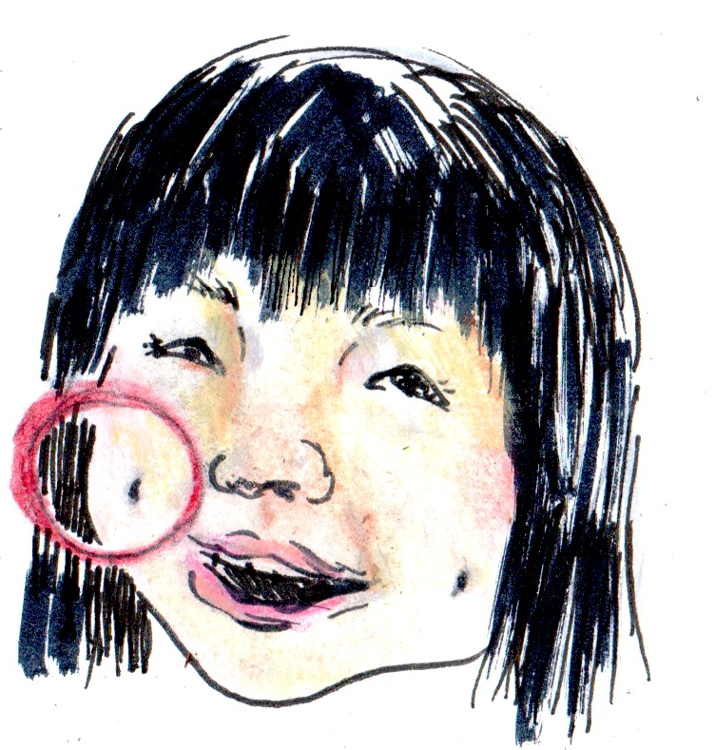
The “lighter side” of DNA analysis
Photic Sneeze Reflex
Finger Length Ratio
Cheek dimples
Notes:
Image: Personal Genetics Education Project (Patricia Hautea)
Slide notes: In addition to information about disease risk, genetic testing can reveal information about interesting but not particularly consequential traits, such as whether or not one has a genetic predisposition that causes people to sneeze when going into the sun, known as photic sneeze reflex. People can learn about the genetic basis of traits such as having dimples, whether their index or ring finger is longer, and a variety of other traits that are unrelated to medical conditions.

Slide 18
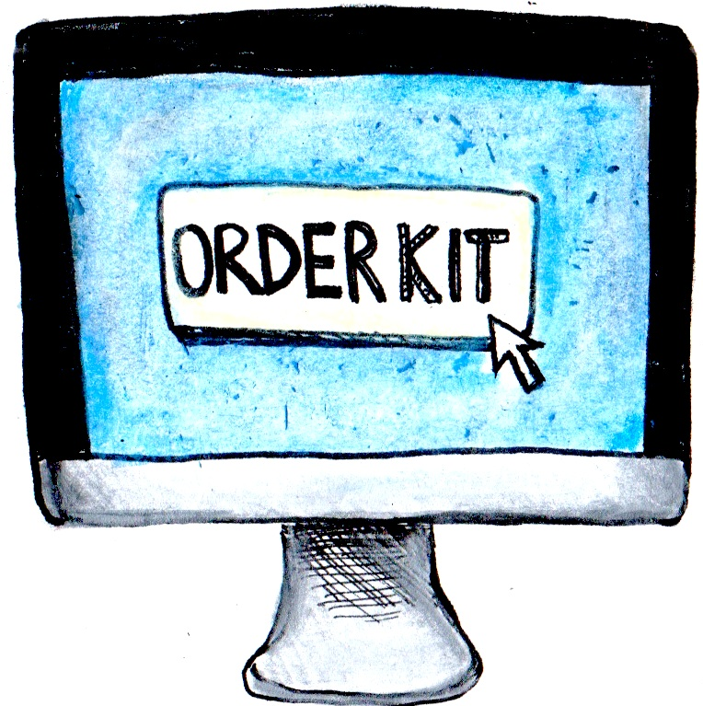
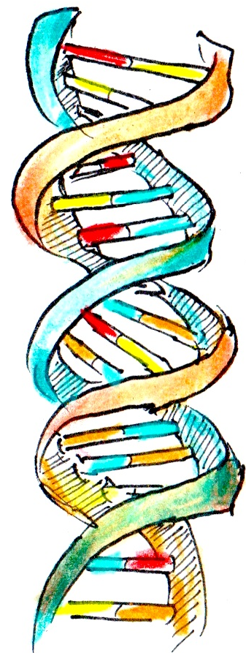
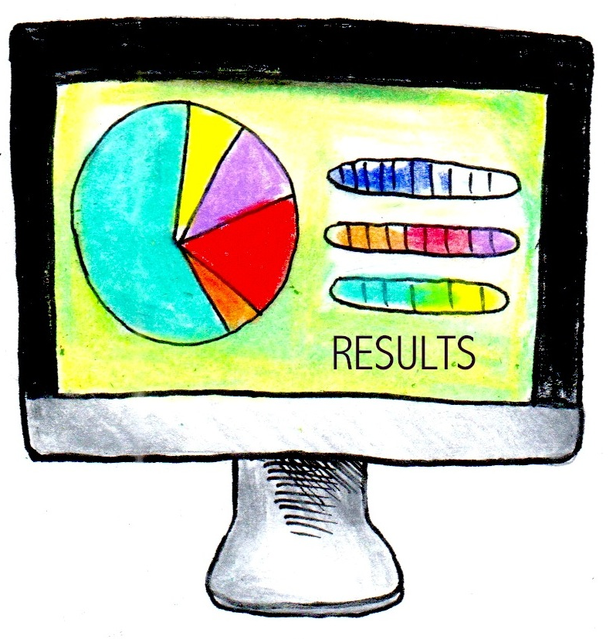
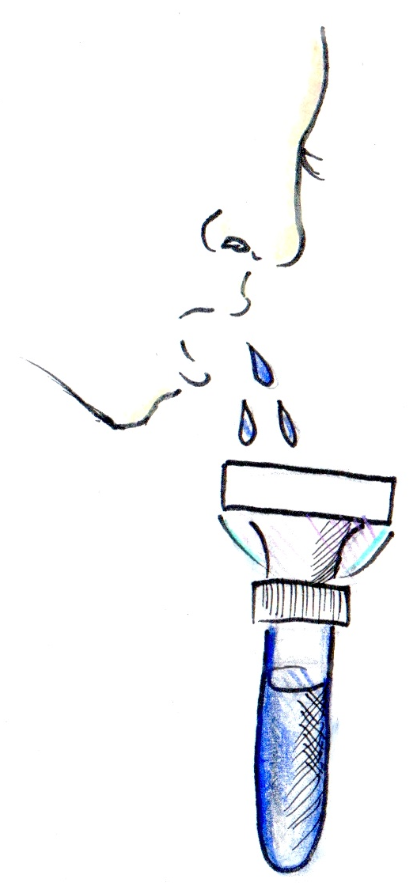
How does direct-to-consumer
genetic testing work?
1. Order kit online.
2. Spit into tube
and send to lab.
3. The lab analyzes DNA.
4. Customer receives results.
Note: Some tests require a doctor’s approval. In this case, results are
typically sent to both the customer and the doctor, so they may discuss.
Notes:
Image: Personal Genetics Education Project (Patricia Hautea)
Slide Notes: The market for direct-to-consumer (DTC) genetic testing has undergone significant change over the last several years. In 2016, the Food and Drug Administration requires that a doctor request a genetic test for a patient. With a doctor’s permission, a patient can order a kit, spit into a tube and send it back to the company for analysis. The doctor and patient both receive the results, and ideally will discuss any questions the patient has, and /or the doctor can refer the patient to a specialist for further consultation.
In the past, customers could buy kits online without a doctor’s permission. People could obtain results about their genetic predisposition for serious diseases, their carrier status for mutations that, if inherited from both parents, can cause serious childhood diseases in their children, as well as interesting but not particularly consequential information about their traits. In 2013, the United States Food and Drug Administration (FDA) intervened, and, in response, 23andMe stopped providing most health information to new customers. At the time of this writing, the FDA has given approval to 23andMe to offer carrier status and information about ancestry and non-medical traits to customers.
There has been much debate over DTC genetic testing, and pgEd has an entire lesson on this topic. One question is whether a genetic testing kit should be considered a medical device. As a medical device, it would be subject to the extensive rules and regulations that oversee safety and quality. In 2016, there are still a number of questions on the path forward for DTC testing.

Slide 19
Challenges in personal genetics
How likely is it you or your doctor can take action based on genetic information?
How might this information impact you and your family?
How can we ensure access for everyone?
Will people understand that our environment (health care, family, society, etc.) also shapes who we are?
Notes:
Slide notes: The potential benefits of personal genetics in medicine are tremendous. Nevertheless, there are scientific, societal and individual challenges as well. Here, we provide information for teachers that can be condensed for students.
1. Clinical utility: Scientists are still learning how to interpret genomes; research is progressing quickly, but much remains to be discovered. There is no simple explanation as to how genes and environment interact to contribute to complex characteristics. Sometimes, there is a strong link between a single gene and a person’s risk for disease; however, this is not always the case. For example, scientists have uncovered over 150 genetic loci that impact a person’s susceptibility for type 2 diabetes and obesity, and it is likely that more remain to be identified. One challenge is to integrate this information in combination with a person’s environmental factors into a meaningful assessment of a person’s risk. One of the concerns about DTC testing is how companies calculate a person’s risk for various diseases. Furthermore, a person’s risk estimates are subject to change over time as new discoveries are made. Individuals who choose to learn about their genetic make-up should therefore be aware of the challenges in making disease risk predictions and have the interpretation of their genome reassessed periodically.
A second question is whether learning about a person’s medical condition or risk for disease is accompanied by a clear medical action for treatment or prevention. Already, there are a few remarkable stories, such as that of the Beery twins for whom genome sequencing has brought both a diagnosis and an effective treatment. For others, genome sequencing has brought a diagnosis without a cure or has not pointed to a diagnosis at all. Improving the clinical utility of personal genetics will require continued efforts in basic and clinical research and medicine.
2. Personal impact: Would you want to know if you are at increased genetic risk for a disease such as cancer, for which there may be a number of steps one can take for prevention or early detection? What about Alzheimer’s disease, which currently has no effective treatment or cure? For some individuals, knowledge is power; information about their disease risks might affect how they choose to live and plan for their future. Others would prefer not to know; one reason might be that it would be impossible to go back and “unknow” this information.
Family impact: Since biological relatives share portions of their DNA, information that people learn about their own genetic make-up may have implications for their family members. For example, imagine a woman whose mother’s family has a history of breast cancer. If she learns that she carries a BRCA1 mutation that puts her at increased risk, there is a good chance that her mother is at increased risk as well. Should she ask her mother’s permission before getting tested? Should she ask her husband’s opinion, because knowing whether she carries the BRCA1 mutation has implications for their long-term planning and for their children?
3. Equality of access: How can we ensure that everyone who wants it can access his or her genetic information? There is general agreement that everyone, regardless of socioeconomic status, should know about the potential benefits of genome sequencing as well as the concerns, but it will take time to implement a comprehensive educational program. Can we ensure equal access? Will insurance companies pay for genome sequencing? Will people enroll in research studies? Will prices continue to fall? Ensuring the accessibility of genome sequencing to all who are interested is a growing issue if we as a society hope to see personal genetics play an increasingly important role in healthcare.
4. The influence of factors beyond genetics: Our physical, mental and behavioral states are the result of complex interactions between many genes in combination with our environment and our lifestyle. For example, a person may have a higher genetic risk for developing obesity or diabetes, but be raised in a family where healthy food choices and exercise counterbalance their genetic predisposition. Similarly, a person may have a higher genetic risk for addiction, but never try alcohol or cigarettes and avoid any likelihood of addiction. Genetic complexity is a key concept in personal genetics, and one that is explored in greater depth in several of pgEd’s lessons.

Slide 20
PTC Lab
We will be amplifying your own DNA to test whether or not you can taste PTC

Slide 21
Ethical, legal, and social issues?
Health benefits
Social Connections
Privacy issues
Fear of genetic discrimination
Preimplantation genetic diagnosis

Slide 22
Informed Consent and Disclosure
What is my DNA sample being used for?
Does my DNA type tell me anything about my life or health?
Can my data be linked personally to me?
Notes:
There is consensus that a human DNA sample should be obtained only with the willing consent of a donor, who understands the purpose for which it is being collected. Thus, this experiment should be explained ahead of time and students given the option to refrain from participating. (Some teachers may wish to have parents sign a consent form, such as those filled out for a field trip.) There is also consensus that a DNA sample be used only for the express purpose for which it is collected. Thus, student DNA samples should be thrown away after completing the experiment.
The TAS2R38 polymorphism was specifically selected to demonstrate the relationship between genotype and PTC-tasting phenotype, because it has no known relationship to disease states or sex determination.
TAS2R38 alleles are inherited in a Mendelian fashion and can give indications about family relationships.

Slide 23
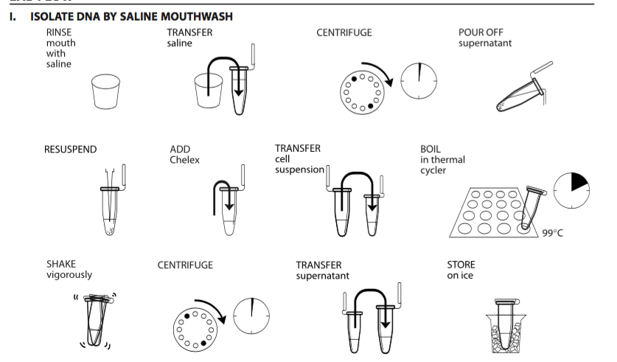
Lab Day 1

Slide 24
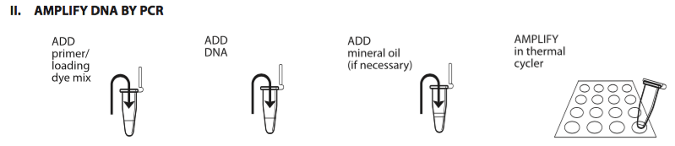
Lab Day 2

Slide 25
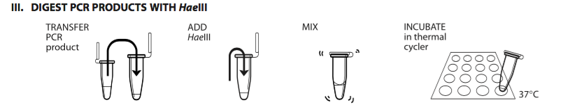
Lab Day 3

Slide 26
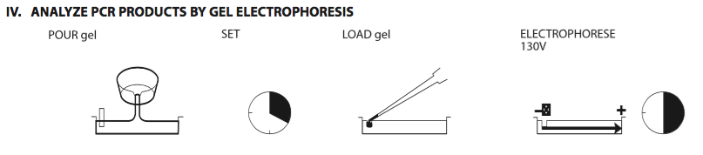
Lab Day 4

